Slide 1

GIT: CONFLICT AND BRANCH

Slide 2
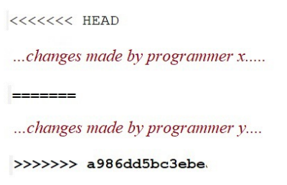
CONFLICT?
How to resolve?
Delete all the merge conflict messages
Push the updated file with steps:
git add <filename>
git commit –m “<commit message>”
git push

Slide 3
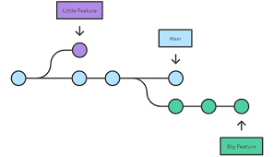
BRANCH
Syntax to check branch:
git branch

Slide 4
HOW TO USE BRANCH
Create new branch:
git checkout –b <branchname>
Push into master:
git add <filename>
git commit –m “<commit message>”
Move to branch main: git checkout main
Merge from origin branch to main: git merge <branch origin name>
git push

Slide 5
ANOTHER GIT SYNTAX
Remove specific file: git rm <filename>
Shows the state of the local repository: git status
Shows all commit information occurred in the project
git log

